Slide 1

Establishing Sustainable Research Data Management in the Neurosciences: The RETAIN Fellowship Program
René Bernard, PhD
Cluster of Excellence NeuroCure
BIH QUEST Center for Responsible Research
rene.bernard@charite.de
15.10.2024 FDM Netzwerktreffen Berlin Brandenburg

Slide 2
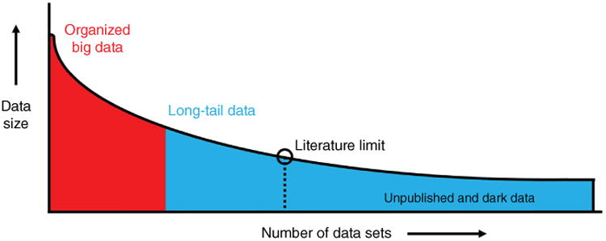
Datafication in Biomedicine (applicable to Neuroscience)
FAIR data
Partly
shared
data
Ferguson et al., 2014, Nature Neuroscience, MacLeod et al., 2014, Lancet
Notes:
Lassen Sie mich beginnen mit einem Einblick aus dem Feld aus dem ich komme, der Biomedizin und der dort existierender Datensätze. Die hier schematisch nach steigender Anzahl und Datengröße dargestellt sind.
Da gibt es den Anteil in rot, der die Grosse Konsortien repräsentiert = Allen Brain Atlas, Human Connectom Project, Human Brain Project, sämtliche genomischen Datensätze = grosse Datensätze, sind gut organisiert, machen zahlenmäßig nur einen geringen Teil der Gesamtheit der produzierten Datensätze
danach beginnen der sogenannte long-tail: kleine, granuläre Datensätze aus individuellen Laboren oder kleinere Kooperationen, teilweise existieren die in Repositorien, oder zumindest die Existenz dieser Datensätze wird berichtet in der Literatur.
Der größe Teil aller Datensätze (85%) der longtail data sind unerreichbar für die Aussenwelt; Daten auf instiutionellen Servern, Festplatten, in Laborbüchern, file drawer data – neutral Ergebnisse.
Wenn man sich überlegt, daß Steuermittel für die Erstellung der Datensätze verwendet wurde, diese aber der Wiederverwertung entzogen warden, kommt man auf einen kumulativen Wert der in etwa dem Weltforschungsbudget eines ganzes Jahres entspricht.
Wie kann das sein?

Slide 3
Complexity in the Neurosciences – Subfields & Subdisciplines
    Computational
    Behavioral
                Molecular
                Developmental
                Clinical
                Cellular
                Sensory
                Systems
                Social
                Evolutionary
Many interdisciplinary approaches
and
techniques in combination
                Neurogenetics
    Neuropharmacology
    Neurophysiology
    Neuroanatomy
    Neuroendocrinology
    Neuroinformatics
    Neuropsychology
Many data have a spacial and temporal component
This complexity is a big hurdle in effective RDM

Slide 4
Research Data Management Questionnaire among NeuroCure PIs and Group Leaders
Researcher’s perspective:
Structured storage and filing
Long term achiving and access
are most important – reflect the use and access to data

Slide 5
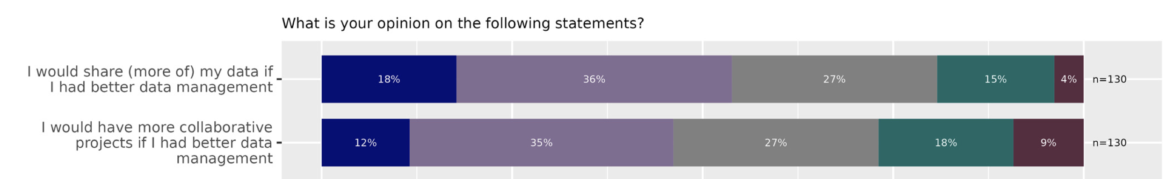
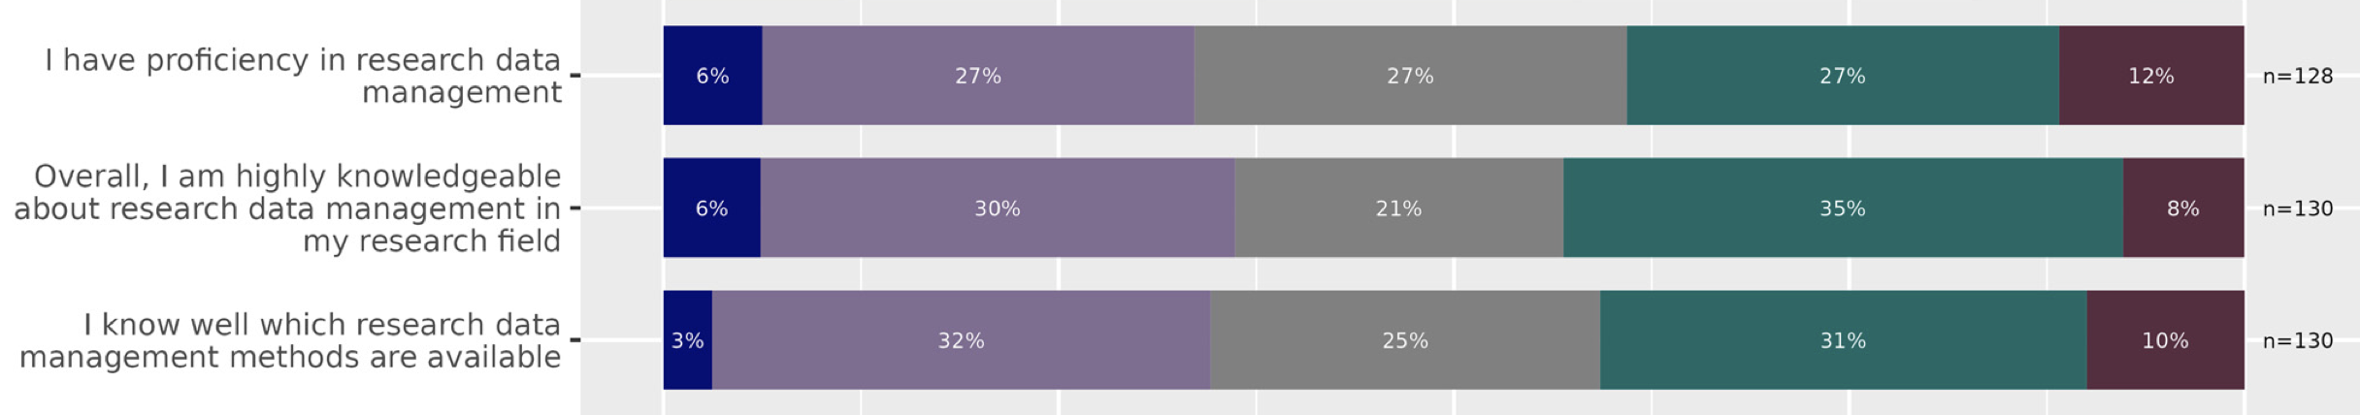
Research Data Management and Data Sharing for Reproducible Research—Results of a Community Survey of the German National Research Data Infrastructure Initiative Neuroscience
Awareness of potential benefits, yet there is a lack of knowledge and best practices
eNeuro 7 February 2023, 10 (2) ENEURO.0215-22.2023; https://doi.org/10.1523/ENEURO.0215-22.2023

Slide 6
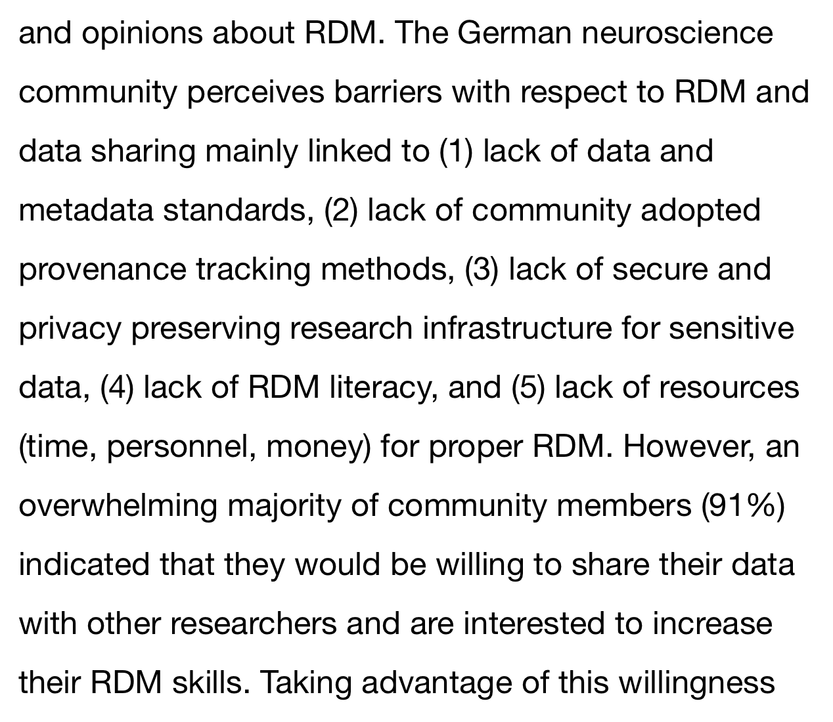
Neuroscientists need support to build a lasting RD infrastructure
From the abstract:
NFDI did not fund the NFDI-Neuro consortium
NFDI4health, NFDI4bioimaging, GHGA
Omics researcher have established international standards and databases
What can we do as Cluster of Excellence ?
eNeuro 7 February 2023, 10 (2) ENEURO.0215-22.2023; https://doi.org/10.1523/ENEURO.0215-22.2023

Slide 7
VOS coordinator actions can help but are limited
  Counseling for DMPs and funding applications
  Course (ReproducibiliTeach) that teaches basic RDM best practices, data dictionaries, and data repository uploads
  But: Review and counseling from within almost impossible + specialized knowledge is required
  There is a clear limit what an outside person is able to do → true changes in RDM infrastructure must be initiated from within a research environment

Slide 8
Overview of RETAIN Program (Research Data Management Implementation in the Neurosciences
Goal: Develop a sustainable RDM infrastructure in a neuroscientific research environment
Who: last PhD student / postdoc student receives a fellowship for 2 years that covers 50% of salary
Applicant shows interest in RDM, data literacy, and willingness to pursue further specialized education
Written proposals require statement of support from the PI for RDM implementation
Fellowship program is overseen by VOS Coordinator (incl. progress tracking)
Proposals and Progress Reports to the NeuroCure Board of Directors

Slide 9
Programm Benefits
VOS coordinator guides and consults fellows
Provides sufficient time to develop and implement best-fitting solutions that work for all
Fellows expertise and skills qualify them for data manager and data steward positions in the future
Show-case labs serve as blueprints for other NeuroCure groups and beyond
RETAIN is a proof-of-concept program but if successful – it is adaptable and scalable

Slide 10
RETAIN application package
Description of RD handling in the research environment (lab standards, conventions, organizational structures for storage, archiving; workflow, if they exist)
Table with : data types, metadata, data processing, data archiving, use of ELN, data access for collaborators, data sharing, legal obligations
If you were to re-use data created by others, which properties and metadata should a dataset have to qualify as reusable?
Description of the ideal RD solution achievable in the research environment
For applications information: general project outline, workplan, and resources
Commitment of support by applicants PI
CV of applicant

Slide 11
Timeline of RETAIN fellowships
Call for applications: 1.6.2023 – 31.7.2023
Review & Evaluations: 15.8.23
Proposal Presentations to BOD: 30.9.23
Start of fellowships: 1.1.24
VOS Progress Meetings: 25.4 and 25.9.24
BOD progress report: 30.11.24
End of fellowships: 31.12.25
Evaluations and follow up monitoring in 2026

Slide 12
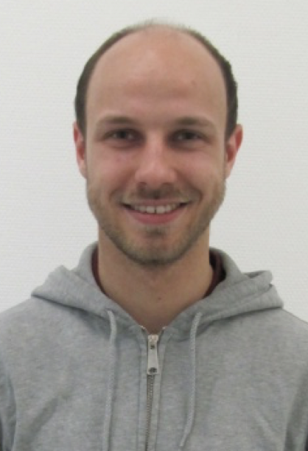
RETAIN fellows
Daniel Parthier, PhD in the lab of Dietmar Schmitz (preclinical)- Charité
Electrophysiology, imaging and behavior
3 recording setups (different makers, different software, different output formats) – get them converted to open NWB format (neurodata without borders)
Synchronized behavioral data and electrophysiological recordings
Setup of “Data onboarding for new lab members”
RETAIN project poster: https://doi.org/10.5281/zenodo.13772103

Slide 13
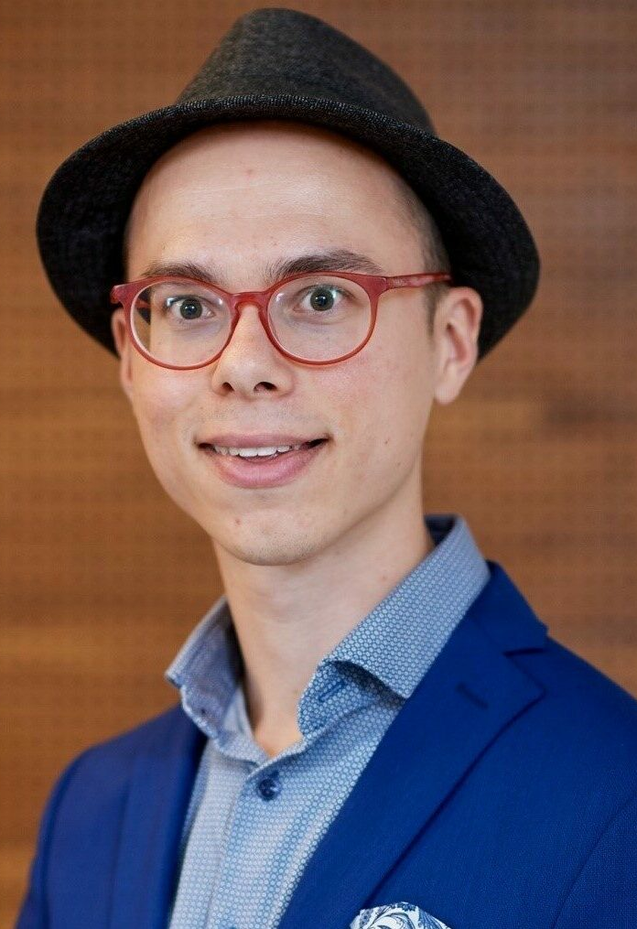
RETAIN fellows
Jojo Vanhöcke, PhD student in the lab of Andrea Kühn (clinical)- Charité
Deep brain stimulation device in patients with Parkinson
human clinical data (e.g. behavioral, clinical, and routine clinical care data), sometimes ”event data” or continuous (home) recordings
Construct a data container analogous to the Brain Imaging Data Structure (BIDS) standard
Share metadata with publications and speed up data transfer agreements by prepared templates
DMP for most common recording setups

Slide 14
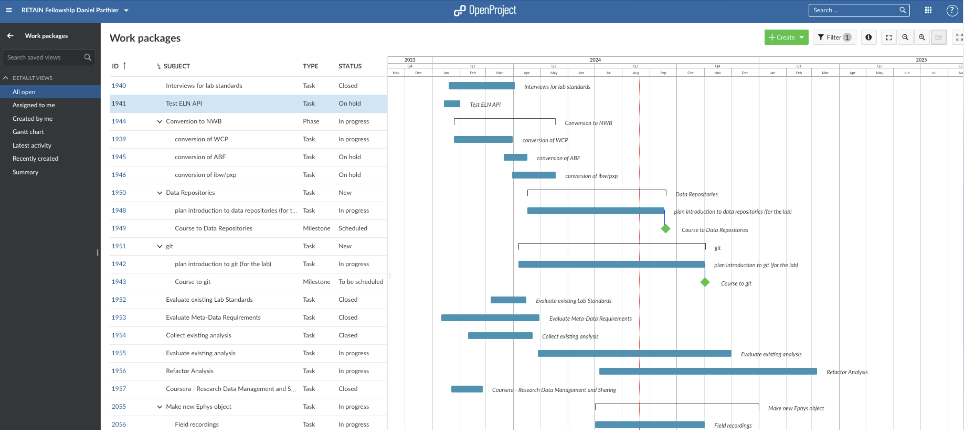
OpenProject for low-threshold RETAIN progress tracking

Slide 15
OpenProject for low-threshold progress tracking
Fellow break up their projects into phases, tasks, and milestones
Fellows’ first exposure to Project Management Software
Transparency increased; potential problems detected
Read access: VOS coordinator, other fellow
Encourage fellows to update OpenProject → email notification
Questions/clarifications: MS Teams
Joint progress meetings every 5 months

Slide 16
SUMMARY
Fellowships for RDM implementation have the potential to generate true progress towards shareable FAIR data
Sharing of the developed solutions can be to adopted by other Neuroscience community members
Generate domain-data-experts that can help others with similar setups, while empowering ECRs
RETAIN concepts needs refinement but overall could be a funding mechanism that can have an impact in the Neuroscience community and make sharing reusable research data the norm
If NeuroCure is continued to be funded: more RETAIN fellowships

